Slide 1
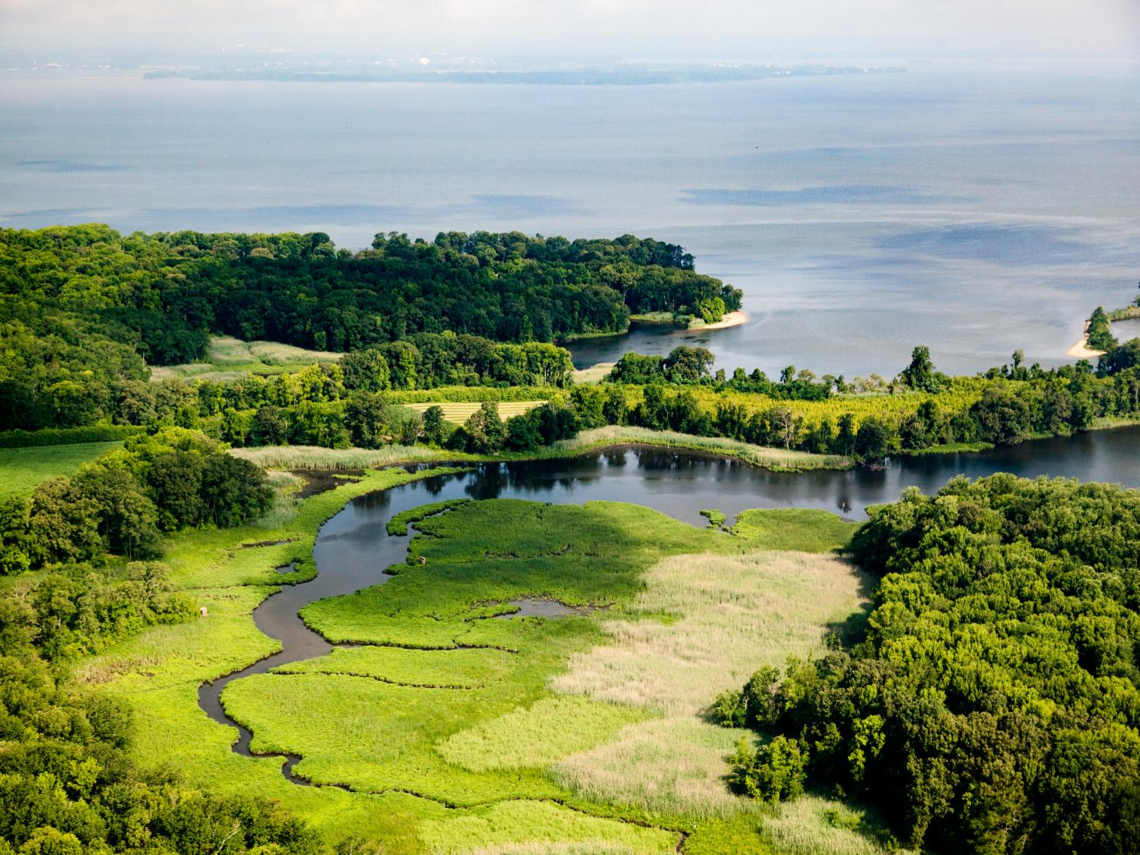
Watersheds – Our Water, Our Home

Slide 2
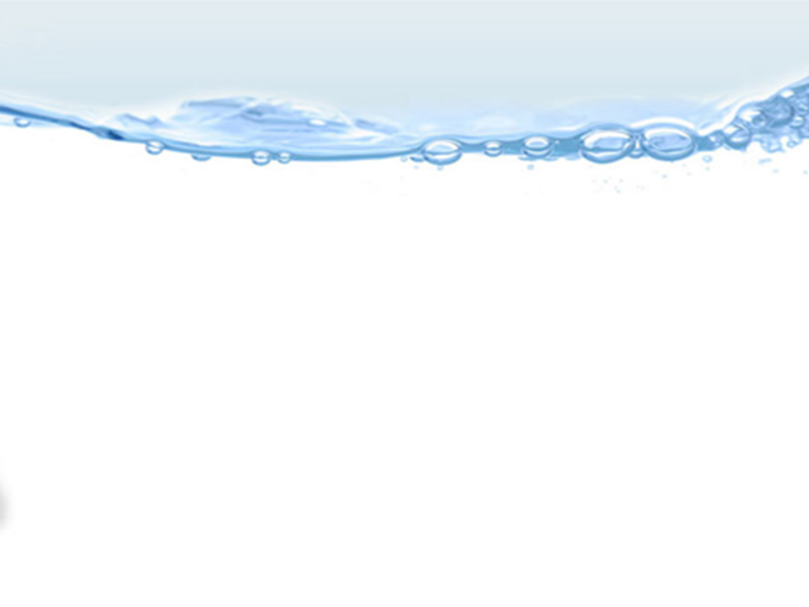
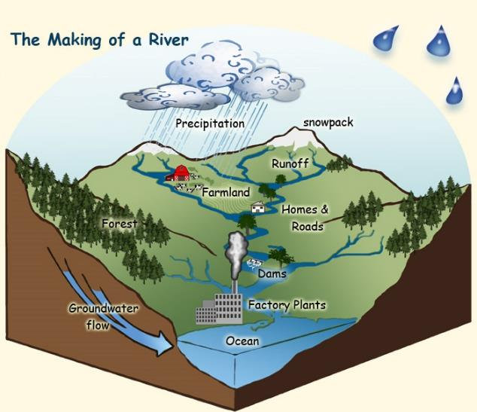
What is a Watershed?
Notes:
A watershed is land that sheds water. Water from rain or snow can flow over the land it falls on. The water can flow to a river, lake, stream or ocean. All of the water under or draining off of a particular watershed goes into the same place. Watersheds come in all shapes and sizes. They cross county, state and national boundaries. Some are millions of square miles, others are just a few acres. Homes, farms, ranches, forests, small towns, big cities and more can make up watersheds. You're sitting in a watershed now.

Slide 3
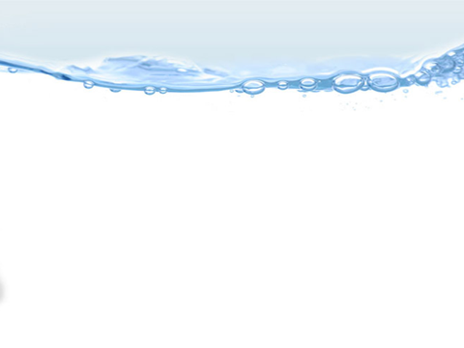
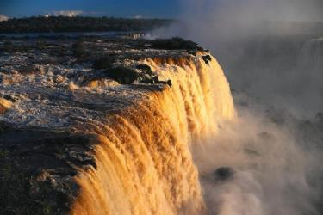
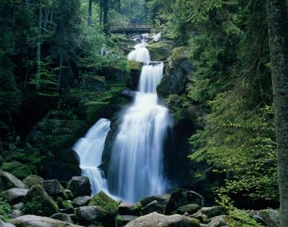
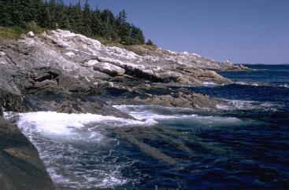
How does Water flow in a Watershed?
Notes:
Gravity helps the rain, sleet, and snow flow from the ground to join the rest of the water in the oceans, lakes, rivers, streams, or ponds.

Slide 4
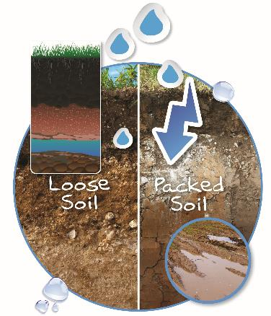
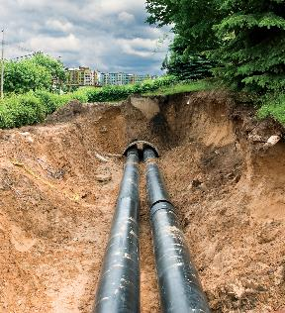
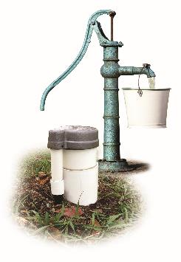
Flowing through the Watershed
Notes:
Water can also soak into the soil until it reaches underground rivers or aquifers. Some rain, sleet, and snow soak into the ground where it is stored as ground water. Groundwater is water that moves through spaces in soil and rock underground.

Slide 5
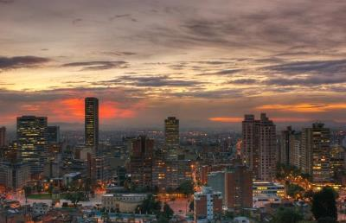
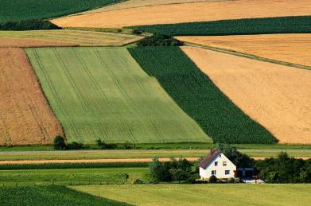
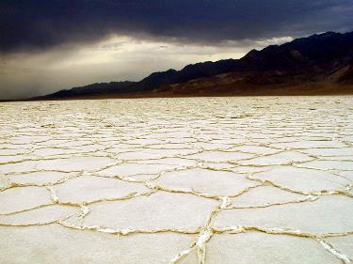
Not all Watersheds are Alike
Notes:
Watersheds can vary greatly in climate, animal life, plant life, human population, amounts of water, and size. Even the desert known as Death Valley is part of a watershed – the Bad Water Basin Watershed. Deserts typically receive ten inches or less of precipitation per year. The rain usually comes in brief downpours resulting in flooding as the water flows across the dry, caked soil. Remember, not all water in a watershed is above ground. Even in the desert, there are underground rivers and aquifers where water flows.

Slide 6
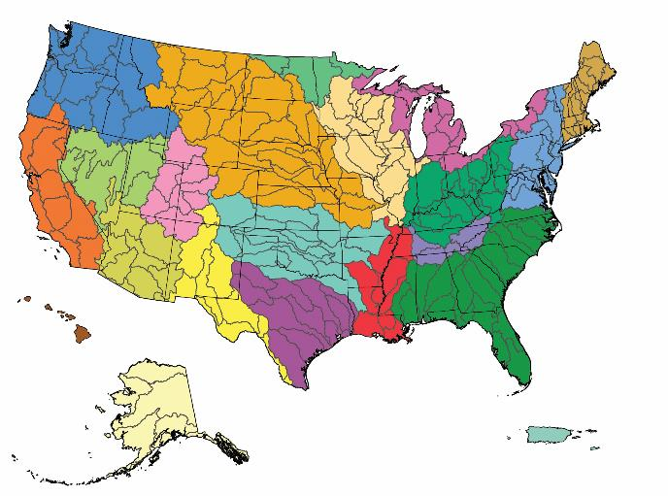
Where is the Watershed?
Notes:
Everywhere! Remember, every piece of land on the planet is part of a watershed. In the continental US, there are 2,100 watersheds. If Hawaii, Alaska, and Puerto Rico are included, the count rises to 2,267 watersheds.

Slide 7
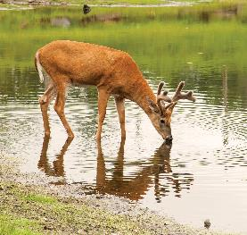
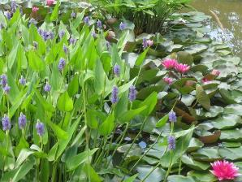
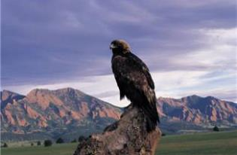
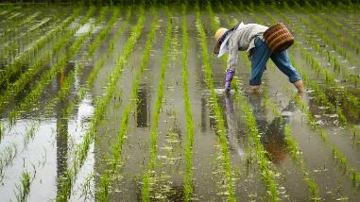
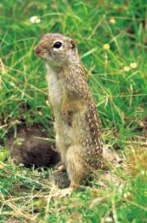
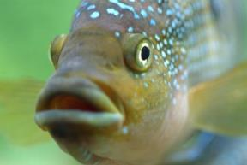
Who Lives in the Watersheds?
Notes:
You and everyone you know lives in a watershed. We share the water in our watershed with other people, with animals and with plants. We all live in the watershed.

Slide 8
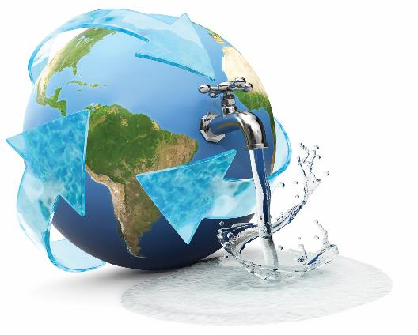
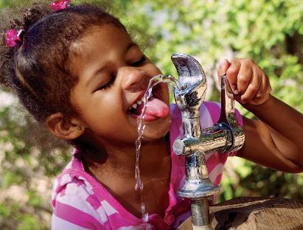
Drinking Shed Water
Notes:
Some of the water you drink comes from your watershed! Water from the watershed drains into lakes, rivers, and streams or through the soil into ground water. The world’s fresh water supply is not new. Our water is being constantly recycled through the earth’s water cycle. A drink of water, whether from a fountain, faucet, or bottle, could be thousands of years old and may have travelled around the world a few times.

Slide 9
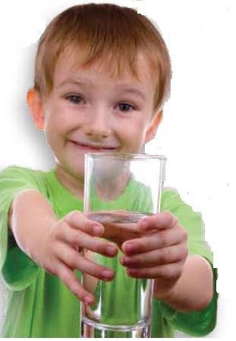
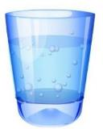
Clean Water is Important
Notes:
The way we treat the land in our watersheds can have a big impact on the water we drink. We each need to drink eight glasses of clean water every day to help keep us healthy. We all need clean water to drink and use in our daily lives. It is very important to take good care of our watershed.

Slide 10
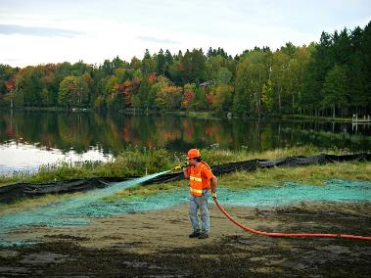
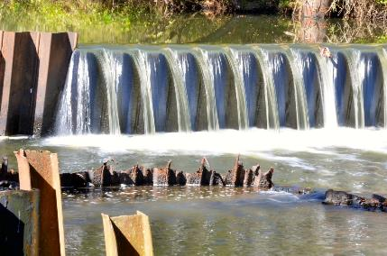
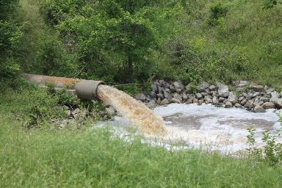
Watershed Conservation
Notes:
We all need to work hard to keep our watershed clean. It is important to take good care of our watershed so that we have fresh, clean water. Only 1% of the water on our planet is fresh useable water. The average person uses 70 gallons of water every day! Tell your family and friends how important it is to practice good conservation habits in your watershed.

Slide 11
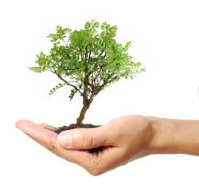
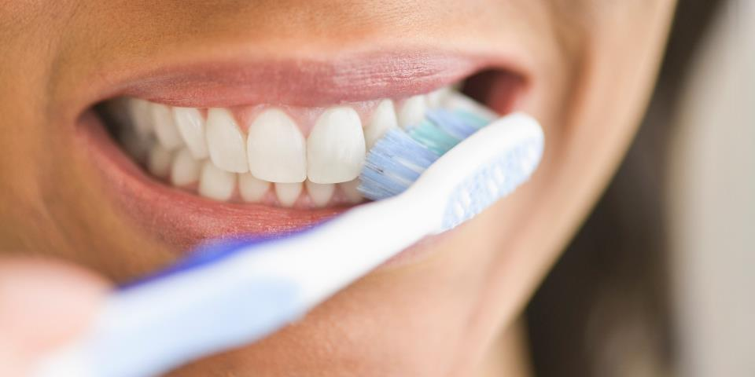
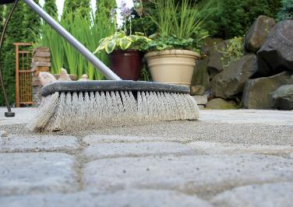
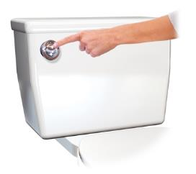
Take action – your drinking water depends upon it
Notes:
Our daily habits are very important to the health of our watershed and our water! Some of our habits keep our watershed healthy, and some of them can harm it.
Turn water off while brushing teeth and flush down toilet. Use a broom instead of a hose to clean sidewalks. Cover bare soil by planting trees, shrubs, flowers, and other plants.

Slide 12
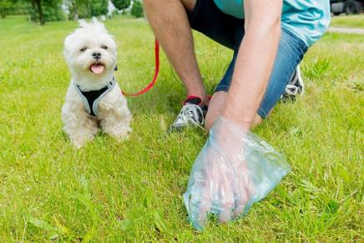
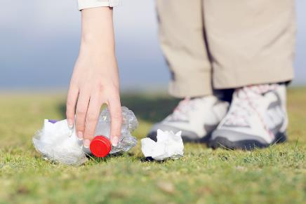
Take Action: Be a Picker Upper!
Notes:
Pick up litter so that it doesn’t end up in a river, lake, or stream. Six out of every 10 homes have a four-legged pet. Do you? Care for your watershed by disposing of pet waste in the trash or toilet. Proper disposal means proper treatment. Pet waste left on the ground can wash into storm drains and ditches. From there it flows into lakes and streams where it can contaminate the water with harmful bacteria.

Slide 13
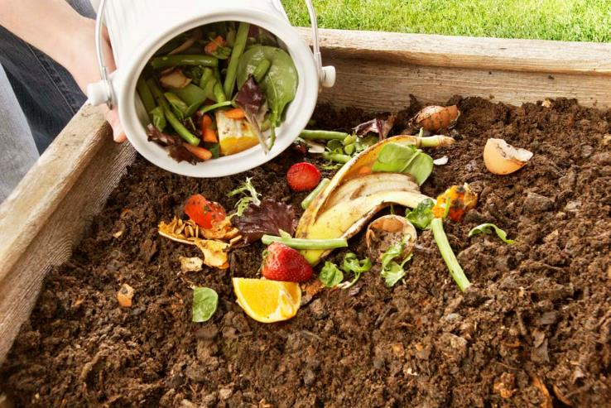
Take Action: Compost
Notes:
Compost leaves, grass, and food. Compost makes a great natural fertilizer and helps keep chemicals out of our water supply.

Slide 14
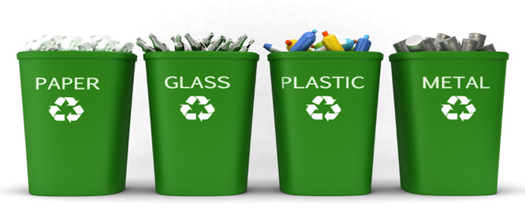
Take Action: Recycle
Notes:
Recycling saves water and other natural resources. Water vapor in the atmosphere condenses to form clouds and weather systems that can travel around the world. Eventually the condensation becomes precipitation in the form of rain, snow, sleet, hail, or fog. Once the precipitation lands, it can do two things: it can be SHED off the land into a body of water like a stream – OR it can soak through the soil until it reaches an underground body of water like an aquifer. Water re-enters the atmosphere to start the cycle all over again by evaporation and transpiration. (click) rain on plant, (click) diagram of soil.

Slide 15
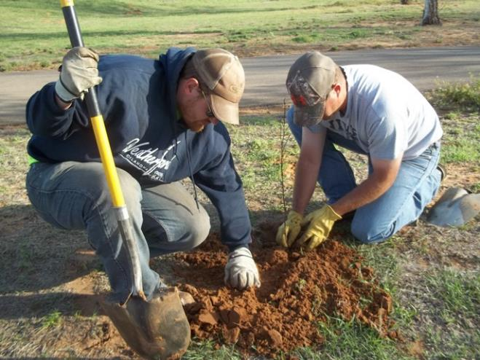
Take Action: Plant and Grow
Notes:
Plant trees, shrubs, and other plants in spots where the soil is bare. Plants help hold the soil in place and keep it from washing into storm drains. If there are bare spots in your yard, get busy planting. Plants prevent erosion which leads to soil being moved through the watershed into our lakes and rivers. Grow some healthy vegetables like broccoli or tomatoes. (click) planting, (click) flowerbed, (click) broccoli, (click) tomato.

